Slide 1





inside
D365 F&O
Invoice solutions

Slide 2


Invoice solutions in D365 F&O
Manual
Other
3rd party Invoice software
Integration
Standard Invoices
Automated
Microsoft Invoice Capture
Eftsure inside ExFlow
Notes:
Highlights Eftsure red, orange, green icons, invoice GST status in all invoice screens , including invoice automation partners.
This feature allows customer to perform vendor management at invoice time rather than payment time.
Invoices being paid usually on day +7/14/30, gives ample time to your vendors to complete their verification workflow before payment is due.
Reduces the risk of late payments, facilitates vendor relationship and improves payment workflow times.

Slide 3
Invoicing / OCR solutions for D365 F&O
Eftsure inside Microsoft Invoice Capture
Eftsure inside ExFlow from SignUp Software
Eftsure inside Microsoft D365 F&O Invoices

Slide 4

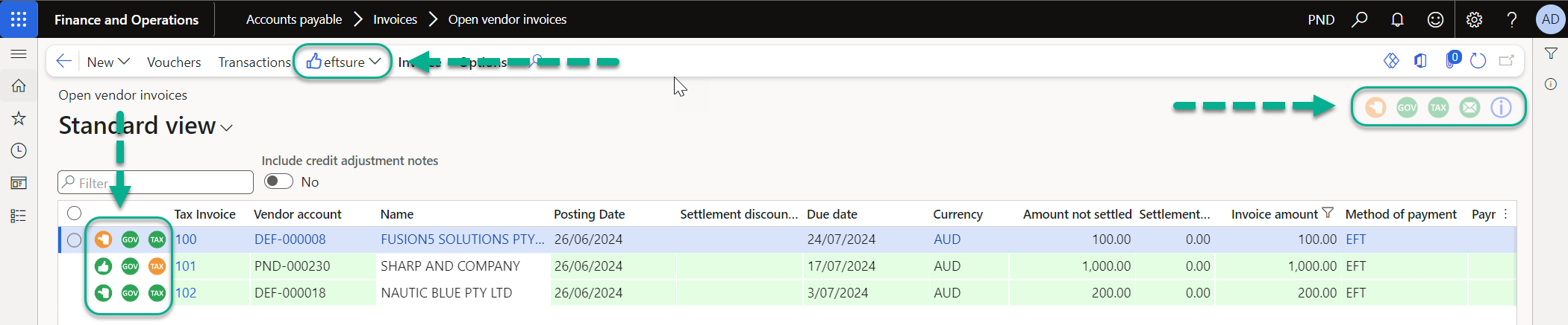
D365 F&O standard invoices

Slide 5
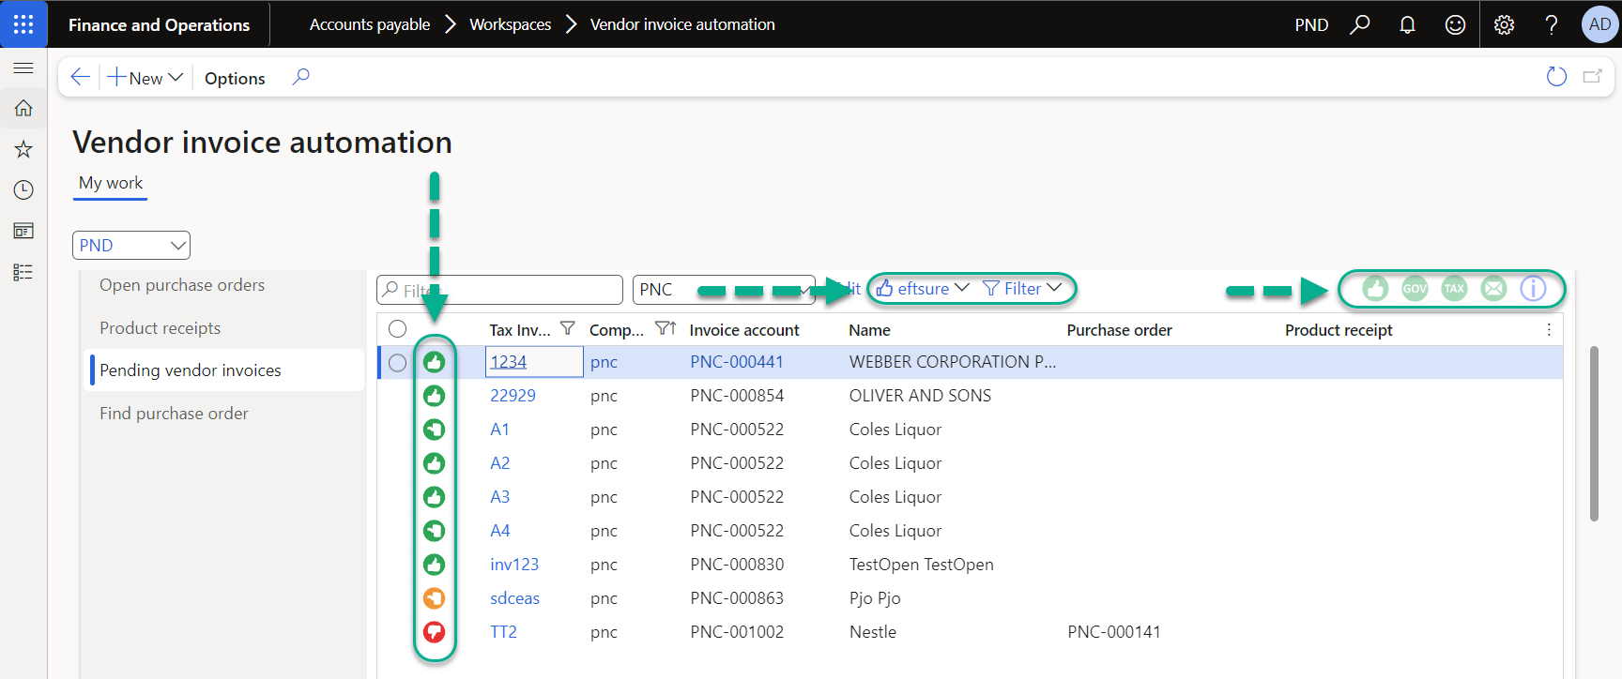
Microsoft Invoice Capture

Slide 6
eftsure inside ExFlow in D365 F&O
Electronic onboarding,
Automated Invoicing,
Secure Payment :
‘The Blueprint of the future
of AP Departments’
Notes:
https://demo.eftsure.net/?cmp=PNT&mi=EXF_mdExFlowAdminWorkspace
https://demo.eftsure.net/?cmp=PNT&mi=EXF_mdImportTableListPage
https://demo.eftsure.net/?cmp=PNT&mi=EXF_mdDocumentTableListPage

Slide 7
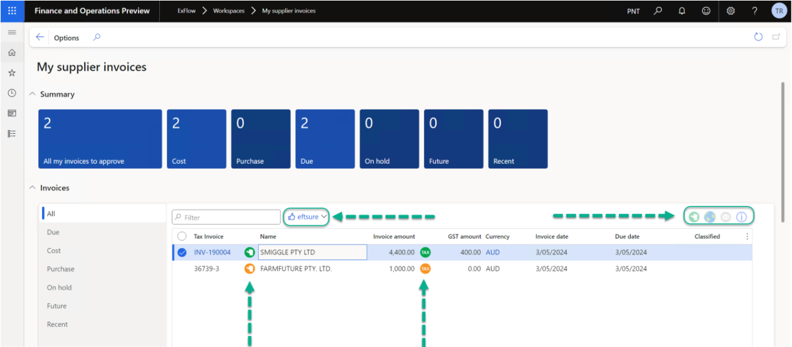
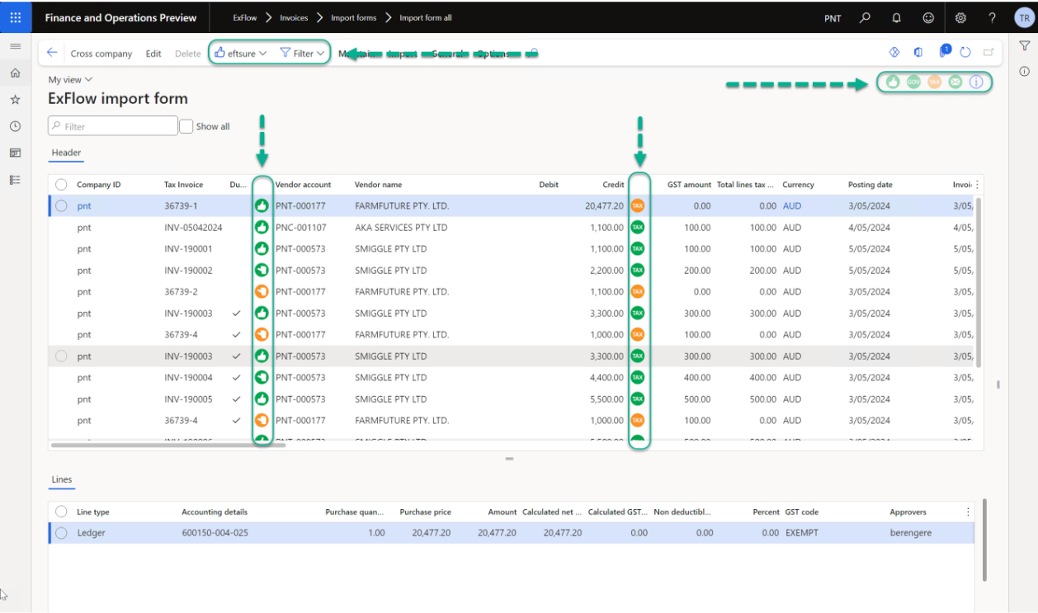
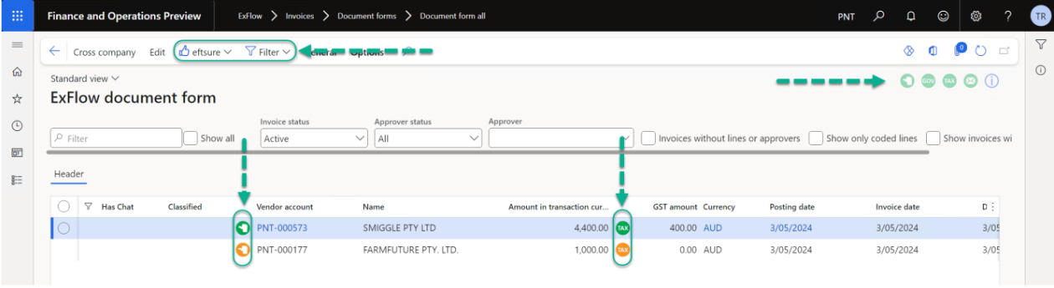
eftsure inside ExFlow

Slide 8
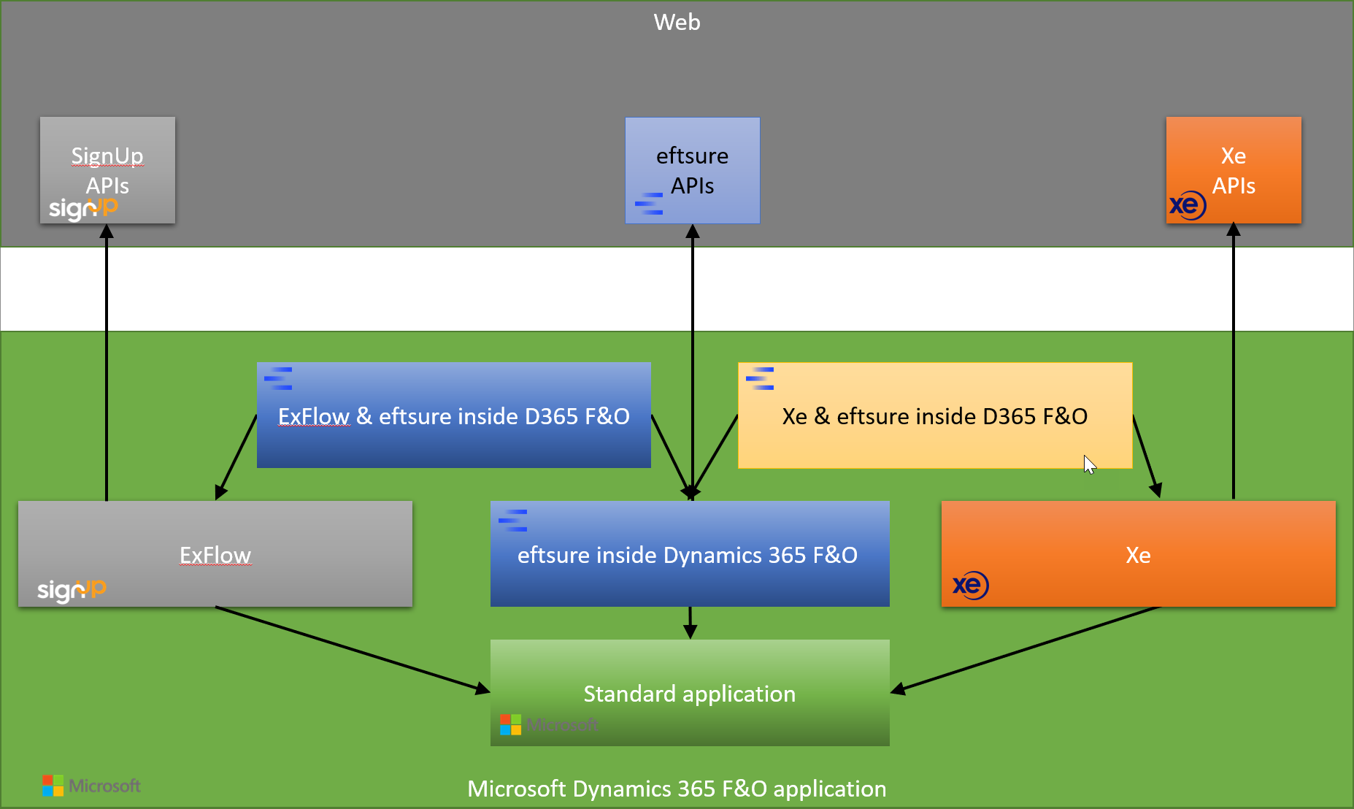
D365 Partnerships
ExFlow FO AP Automation
Accounts Payable and Invoice Process automation for Microsoft Dynamics 365 for Finance and Operation
Xe Global Payments for D365 Finance
Simplify & automate your global vendor payment process with a real-time embedded currency solution

Slide 9
eftsure inside ExFlow in D365 F&O
Electronic onboarding,
Automated Invoicing,
Secure Payment :
‘The Blueprint of the future
of AP Departments’
Notes:
https://demo.eftsure.net/?cmp=PNT&mi=EXF_mdExFlowAdminWorkspace
https://demo.eftsure.net/?cmp=PNT&mi=EXF_mdImportTableListPage
https://demo.eftsure.net/?cmp=PNT&mi=EXF_mdDocumentTableListPage

Slide 10
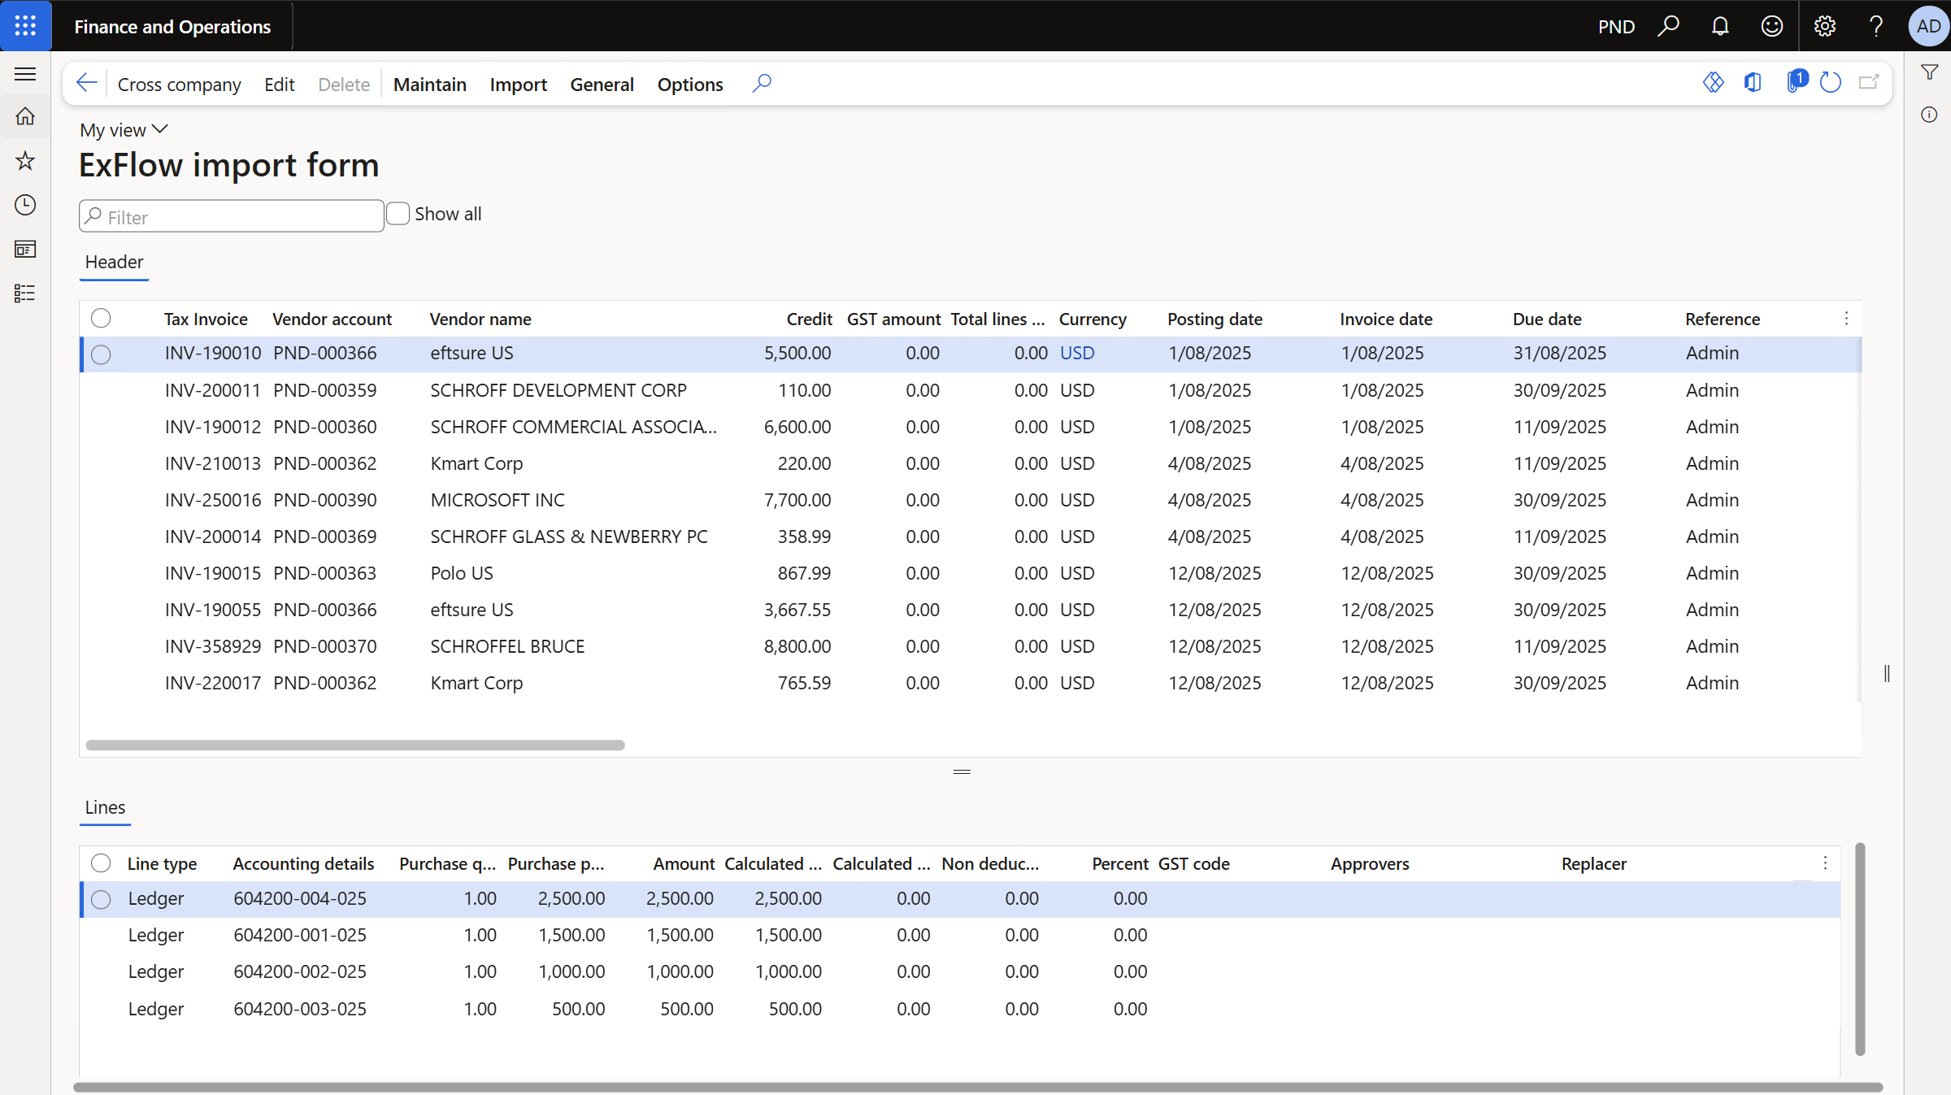
ExFlow alone
Notes:
https://demo.eftsure.net/?cmp=PNT&mi=EXF_mdExFlowAdminWorkspace
https://demo.eftsure.net/?cmp=PNT&mi=EXF_mdImportTableListPage
https://demo.eftsure.net/?cmp=PNT&mi=EXF_mdDocumentTableListPage

Slide 11
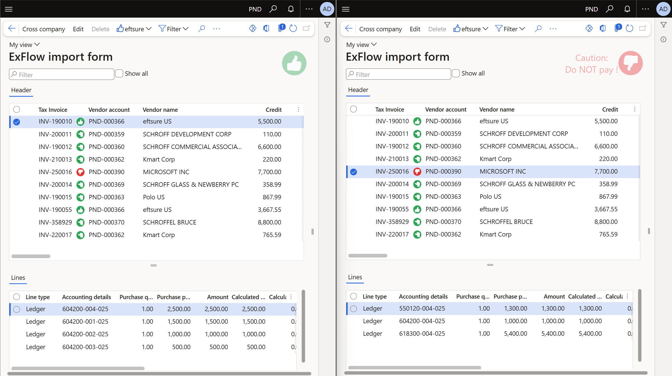
eftsure inside ExFlow in D365 F&O
Notes:
https://demo.eftsure.net/?cmp=PNT&mi=EXF_mdExFlowAdminWorkspace
https://demo.eftsure.net/?cmp=PNT&mi=EXF_mdImportTableListPage
https://demo.eftsure.net/?cmp=PNT&mi=EXF_mdDocumentTableListPage

Slide 12
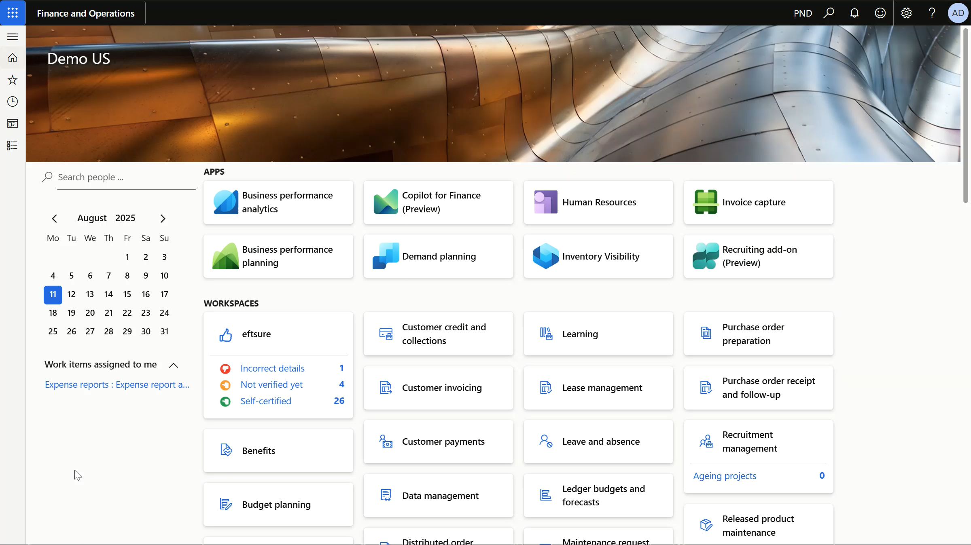
eftsure inside ExFlow in D365 F&O
Notes:
https://demo.eftsure.net/?cmp=PNT&mi=EXF_mdExFlowAdminWorkspace
https://demo.eftsure.net/?cmp=PNT&mi=EXF_mdImportTableListPage
https://demo.eftsure.net/?cmp=PNT&mi=EXF_mdDocumentTableListPage

